Slide 1
Color Control Android Application
Alex Herbon, Mike Damman
Andrew Koeck, Scott Miller

Slide 2


The Project
Project Advisors
Dr. Kiumi Akingbehin Dr. Bruce Maxim
Client
Jeff Golotta Dan Anthony
Start Date: September 5th, 2012
End Date: April 22, 2013
College of Engineering and Computer Science

Slide 3
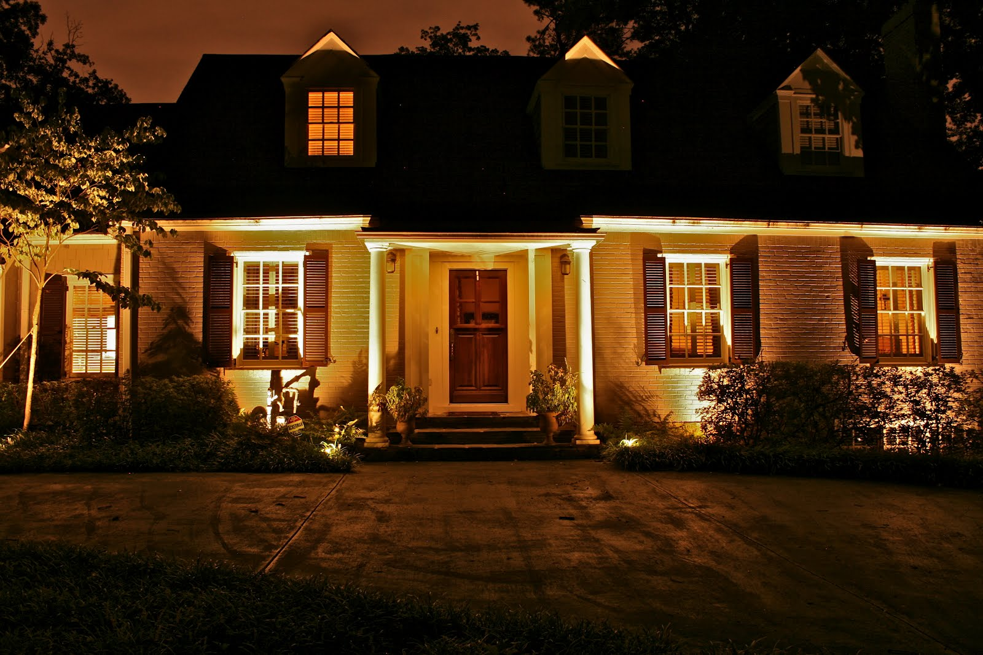
Summary: The Problem
LED landscape lighting with adjustable colors
Users have to adjust their lights from a connected control box
Inconvenient for fine tuning settings

Slide 4
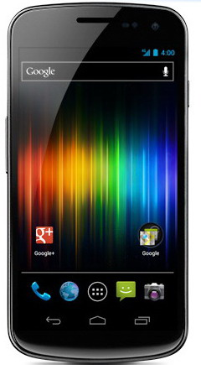
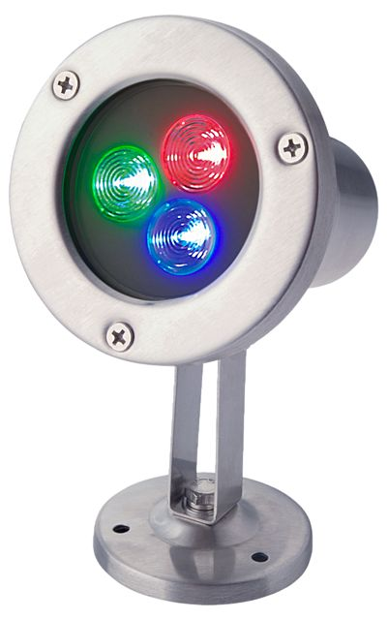

Summary: The Solution
A way to adjust light settings wirelessly.
Set custom colors and send them to the control box directly
Done through the user’s smart phone

Slide 5

Our Project
An application for Android smart phones
Lets you use a touch screen interface to create and save your own colors
Uses sliding bars to select amounts of red, green, and blue color
Then sends the data to the lighting control box

Slide 6
Application Design/Features
Interface driven design
Easy to understand and use
All features accessible through minimal navigation
Utilizing Agile development methods with rapid prototyping for our client
Color and brightness adjustment
Save, change, and delete multiple color combinations
View current color combination
Bluetooth connectivity
Set auto start/end times

Slide 7
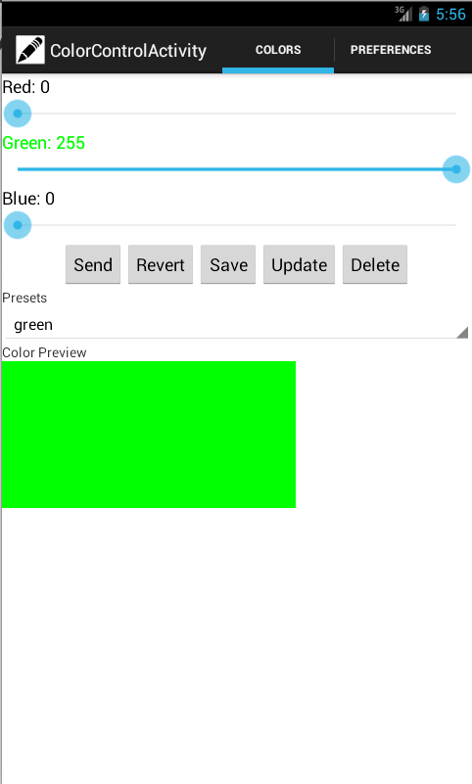
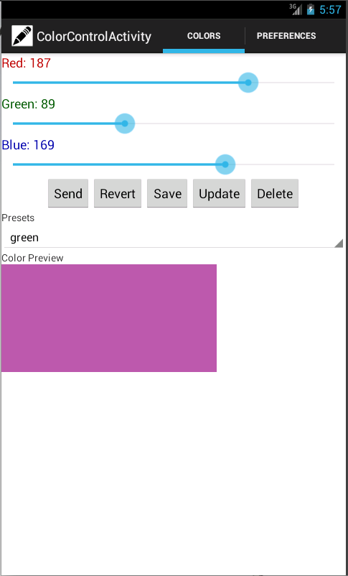
The Interface

Slide 8
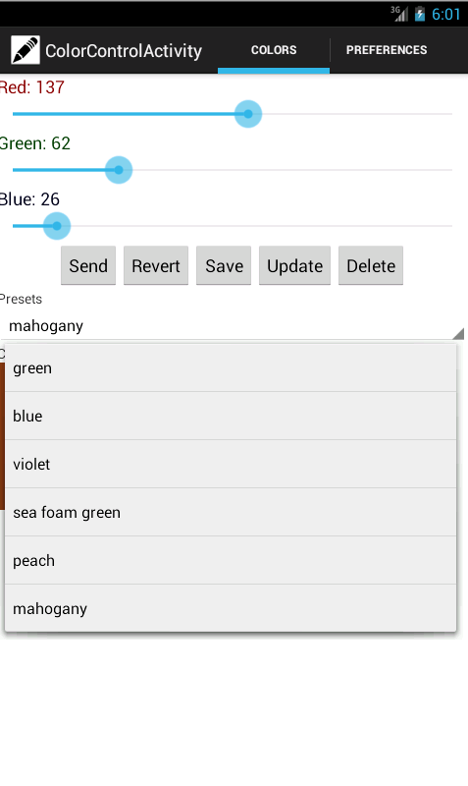
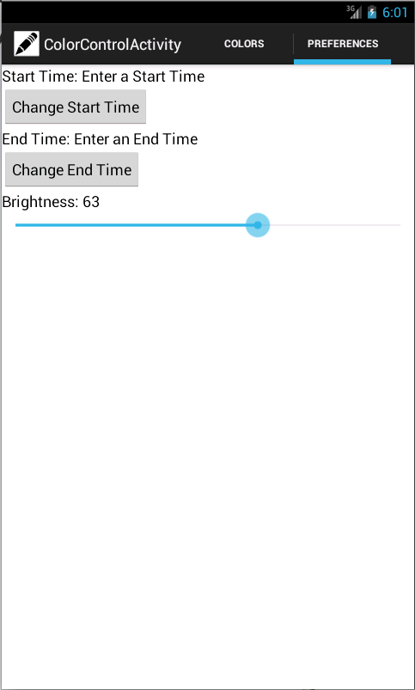
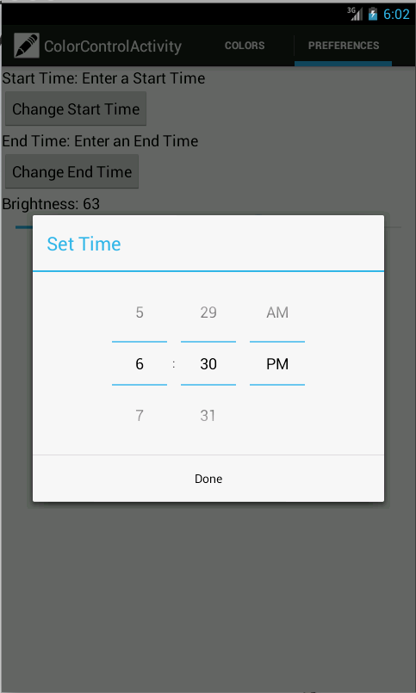
The Interface

Slide 9



Additional Notes
Designed for Android Version 2.4 and up
Tested with more recent hardware in mind
Samsung Galaxy series
Google Nexus series
Not distributing through Google Play store
Client to offer directly to customers
Coded in Java, using Eclipse IDE

